Slide 1

Location Consultation for Py-Resorts

Slide 2

Overview
Our firm, PyConsult, has been hired by a high-end luxury resorts company, PyResorts, to research locations and advise them on potential places to build a new resort.
They are looking for tropical and safe destinations.

Slide 3
Objectives
Recommend potential locations based on the following criteria:
Ideal climate range
An existing airport
Low number of hotels
Tourist attractions (natural & man-made)
Low levels of crime within the Country

Slide 4
Questions to ask
1.Based on climate parameters and a limited number of hotels, which countries have the most cities and the lowest crime index?
2. Is there a correlation between population and crime index?
3. Is there a relationship between the number of attractions/restaurants and the number of hotels in each city?

Slide 5

Data sources
Source of place data:
https://www.geoapify.com/
Crime source:
https://worldpopulationreview.com/country-rankings/crime-rate-by-country
Source of weather data:
https://openweathermap.org/apier

Slide 6
Climate Parameters for Cities on Open-Weather
Latitude Range: - 34 to 37 degrees
Temperature Range: 75.2F (24C) – 86F(30C)
Humidity: Greater than 20% and less than 70%
Wind Speed: Less than 8mph
Cloudiness: No clouds in the sky

Slide 7
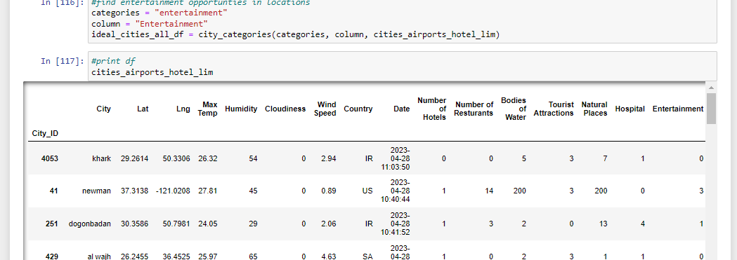
Data Collection on GeoApify

Slide 8
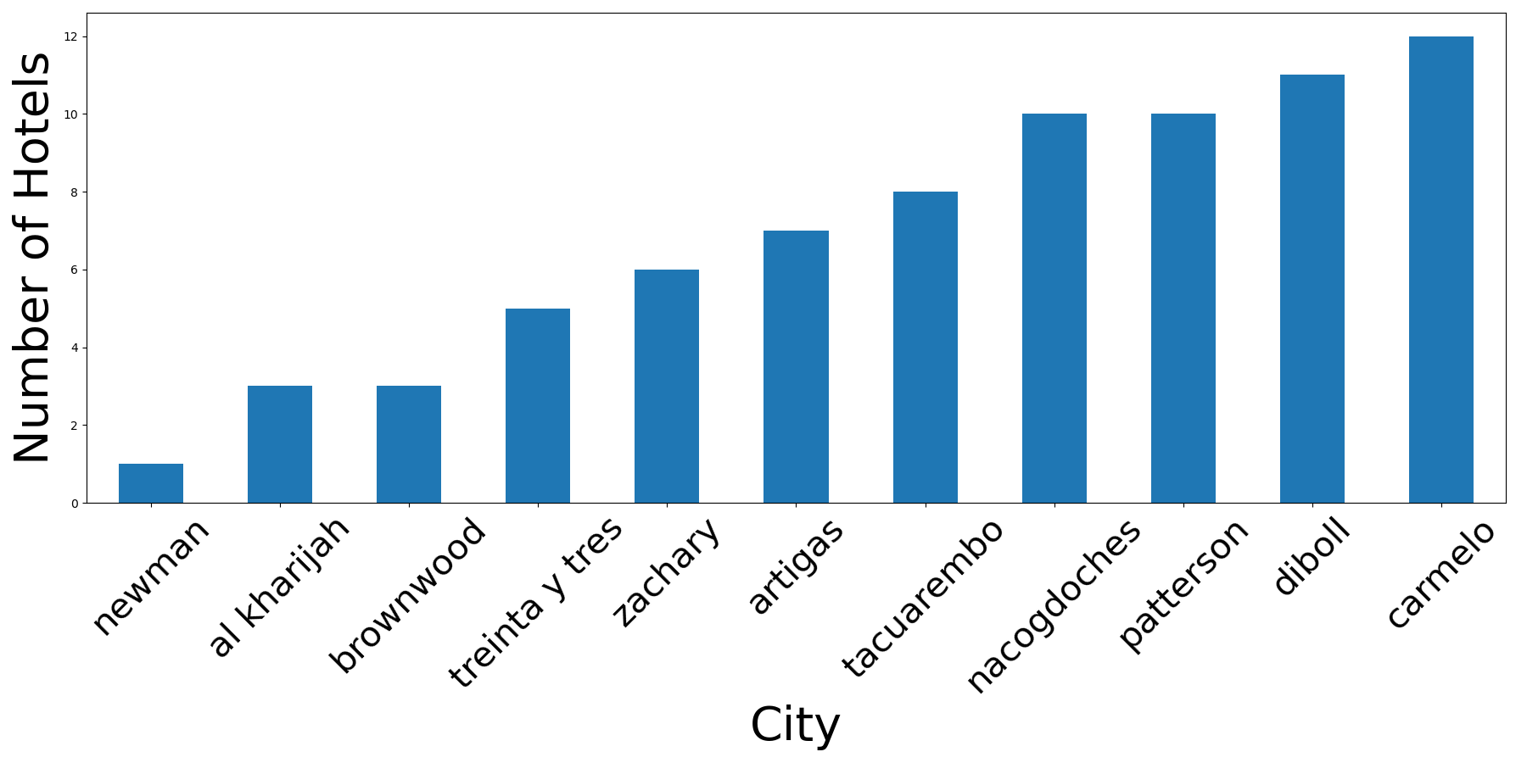
Cities with the fewest number of Hotels

Slide 9
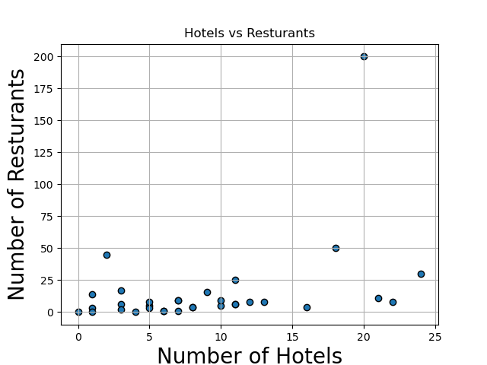
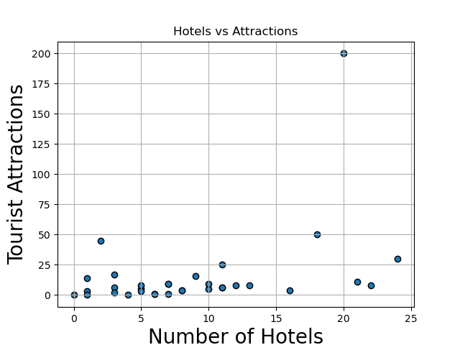
Number of Hotels compared to Restaurants and Tourist Attractions

Slide 10
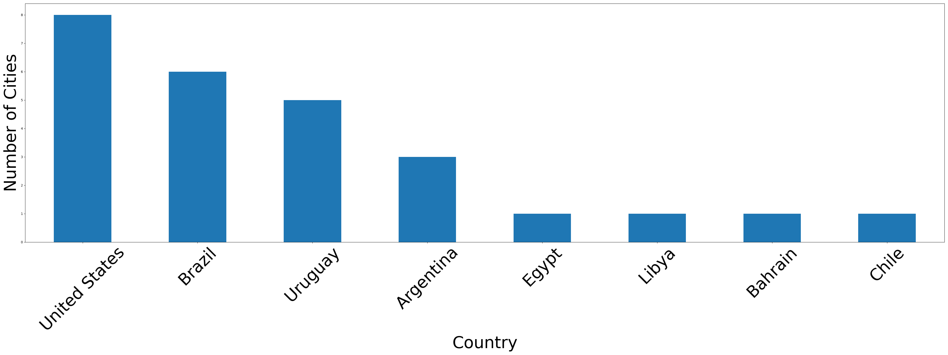
Number of Cities per Country

Slide 11
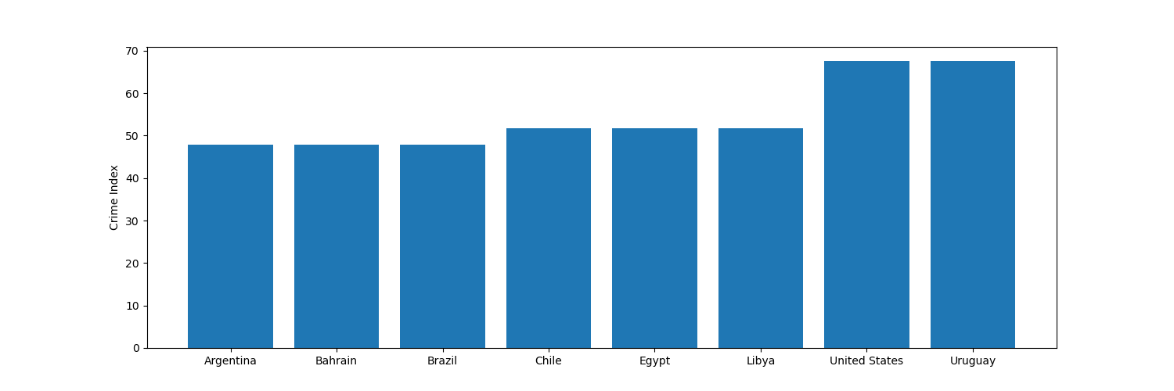
Crime index for each recommended country

Slide 12
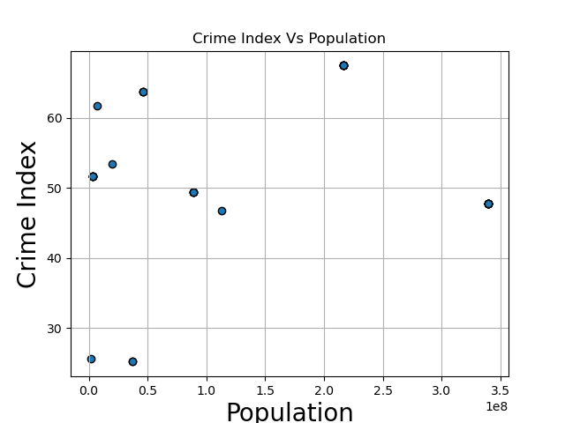
Crime Index vs Population in each Country

Slide 13
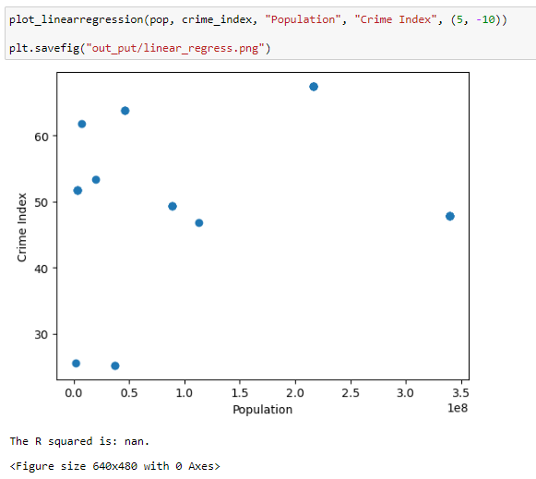
Does Population size predict crime Index?

Slide 14
Compare Crime index to United Nations Data
United Nations Office on Drugs and Crime
https://dataunodc.un.org/
Keeps records on several categories of crime
Data gathered from:
Drug, Firearm, and Human Trafficking
Homicide, Violent and Sexual Crime
Corruption and Economic Crime
Is it possible to get a more granular view of global crime?
Data is only recorded at the country level
Many subcategories listed to understand what types of crime are reported

Slide 15
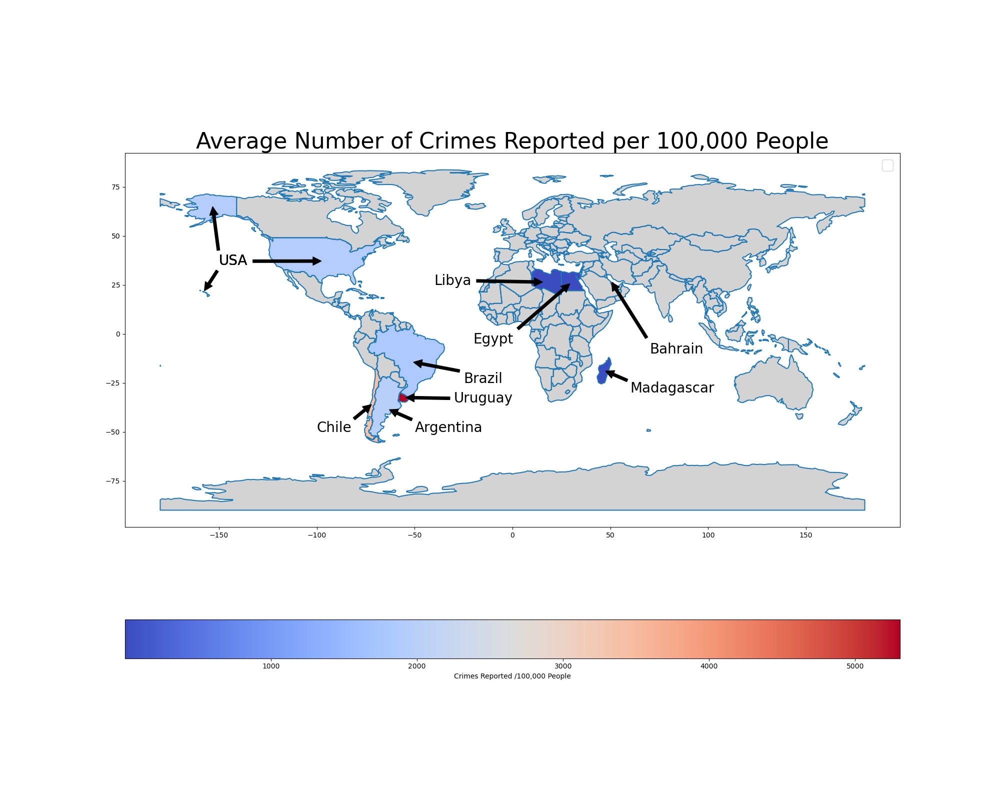
Compare Crime index to United Nations Data
Highlighted countries selected from ideal city candidates
The redder the color, the more reported crimes
Why does Libya, Egypt and Madagascar show low crime rates?

Slide 16
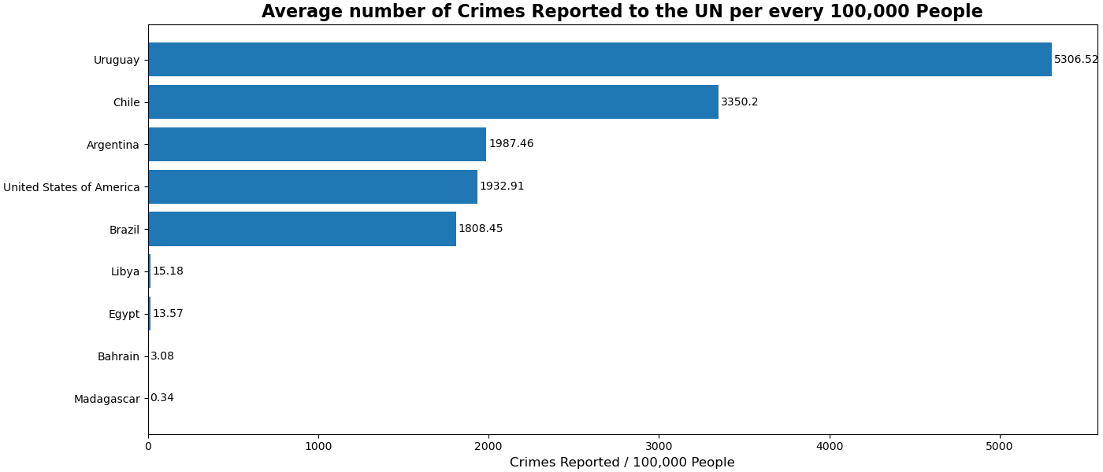
Compare Crime index to United Nations Data
Libya, Egypt, Bahrain, and Madagascar have lower than expected reported crimes

Slide 17
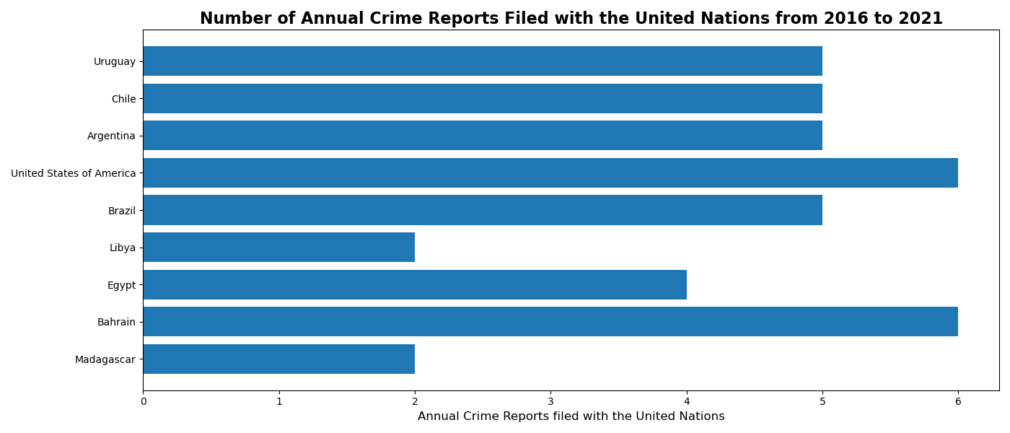
Compare Crime index to United Nations Data
Libya, Egypt, and Madagascar have fewest annual reports filed than over countries

Slide 18
Compare Crime index to United Nations Data
Based on the information scraped from the United Nations:
The safest country is Bahrain
Brazil and Argentina are just as dangerous as the United States
Avoid Chile and Uruguay
Considering United Nations Data
Requires countries to record and report crime
Vast repository for historical country crime statistics from at least 1980
Categorical listing of crime counts by category
Considering Crime Index
Data represents only one year
Only covers 137 international cities
Summary crime index calculations are not disclosed

Slide 19
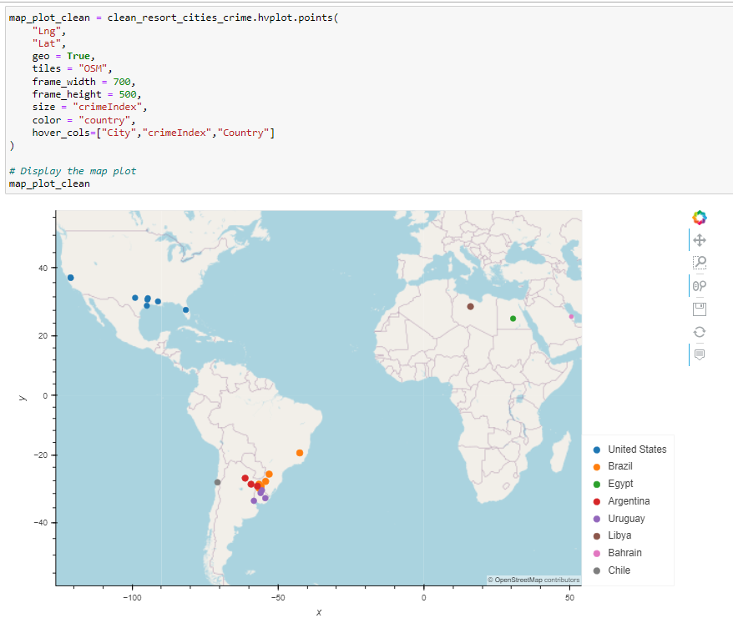
Locations on the Map
Suitable locations based on climate, crime index & number of hotels

Slide 20
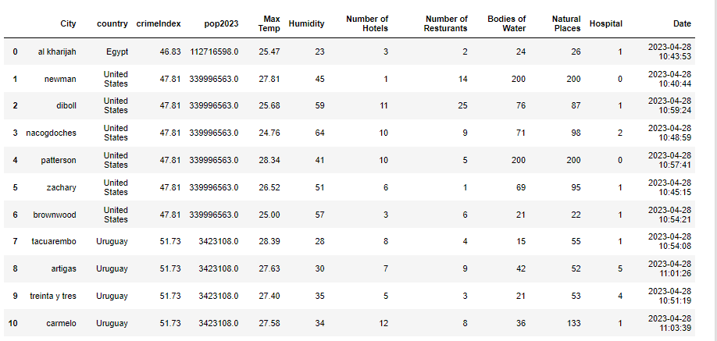
Data-frame of final locations

Slide 21
Top 10 city Recommendations:
1.) Al kharijah, Egypt
2.) Brownwood, US
3.) Zachary, US
4.) Patterson, US
5.) Nacogdoches, US
6.) Diboll, US
7.) Newman, US
8.) Treinta y Tres, Uruguay
9.) Artigas, Uruguay
10.) Tacuarembo, Uruguay
Source for world crime data (2023):
https://worldpopulationreview.com/country-rankings/crime-rate-by-country

